Slide 1
Decision Tree and Time Series Models for Predicting Housing Prices in the Alameda County
Capstone project presentation
Pardeep Kumar

Slide 2
Why Housing Price Predictions?
Indicator of market health.
Helps different parties in decision making:
Homebuyers,
Sellers,
Real estate agents,
Insurers, etc.

Slide 3
Objective
To predict housing prices in Alameda County using
Decision Tree Models
Time Series Forecasting
Dynamic Regression Model
Ultimate goal is to identify factors that impact the housing price growth in the Alameda County

Slide 4
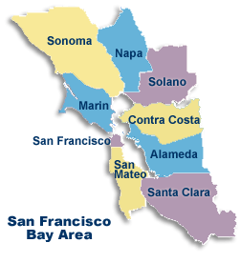
Geographic Location
Alameda County is located in the San Francisco Metro, CA.
6 other neighboring counties were included in the study
San Francisco County
Marin County
San Mateo County
Santa Clara County
Contra Costa County
Solano County
(Photo courtesy of Bay Area Census webpage)

Slide 5
Predictive Modeling
Decision Trees
Bagging
Random Forest
Time Series Forecasting
Holt’s Exponential Smoothing
ARIMA Models
Time Series Forecasting
Dynamic Regression Model
ARIMA Model with 2 breakpoints

Slide 6
DECISION TREE MODELS

Slide 7
Time Series Model: Predictors
S. No. | Predictor | Region
1 | Housing Price Time Series | Contra Costa County
2 |  | Marin County
3 |  | San Francisco County
4 |  | San Mateo County
5 |  | Solano County
6 |  | Santa Clara County
7 | Time | -NA-
8 | Population | Alameda County
9 | Consumer Price Index | San Francisco-Oakland-Hayward
10 | Monthly Housing Inventory | Alameda County
11 | Monthly Turnover Rate | Alameda County

Slide 8
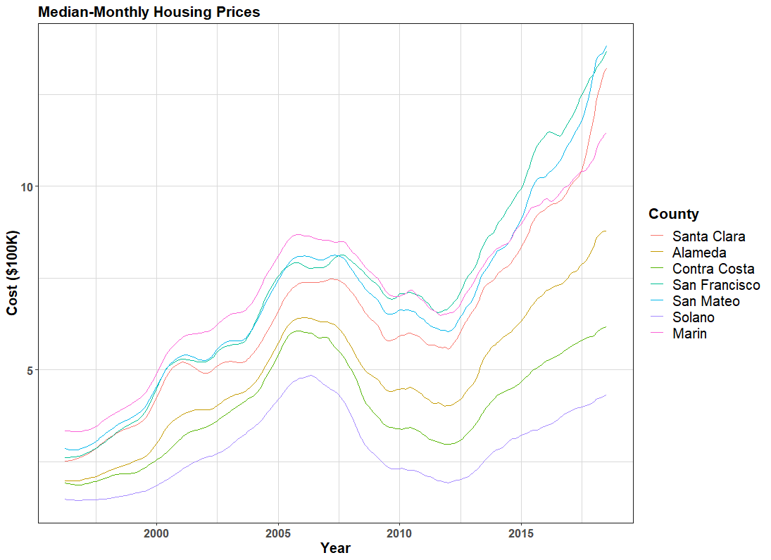
Time Series Model: Housing Prices
Median monthly housing prices of each county was obtained from Zillow webpage*.
The time series have two positive trend and one negative trend corresponding to the real estate financial crisis of 2008.
In recent years, housing prices in San Francisco and San Mateo county have increased rapidly.
Visually, time series didn’t seem to have any seasonality.
All 6 counties were highly correlated to the Alameda County.
*(www.zillow.com/research/data)

Slide 9
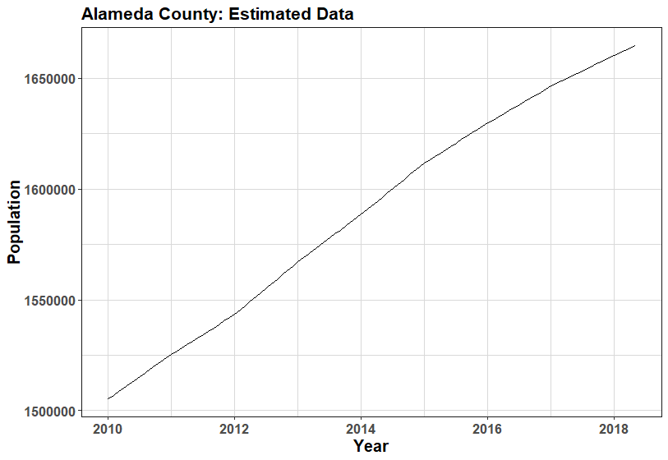
Time Series Model: Population
Annual population estimates were obtained from Department of Finance webpage*.
Population of Alameda County increased almost linearly each year.
Monthly population was computed by linearly interpolating between two annual estimates.
*(http://www.dof.ca.gov/Forecasting/Demographics/Estimates/)

Slide 10
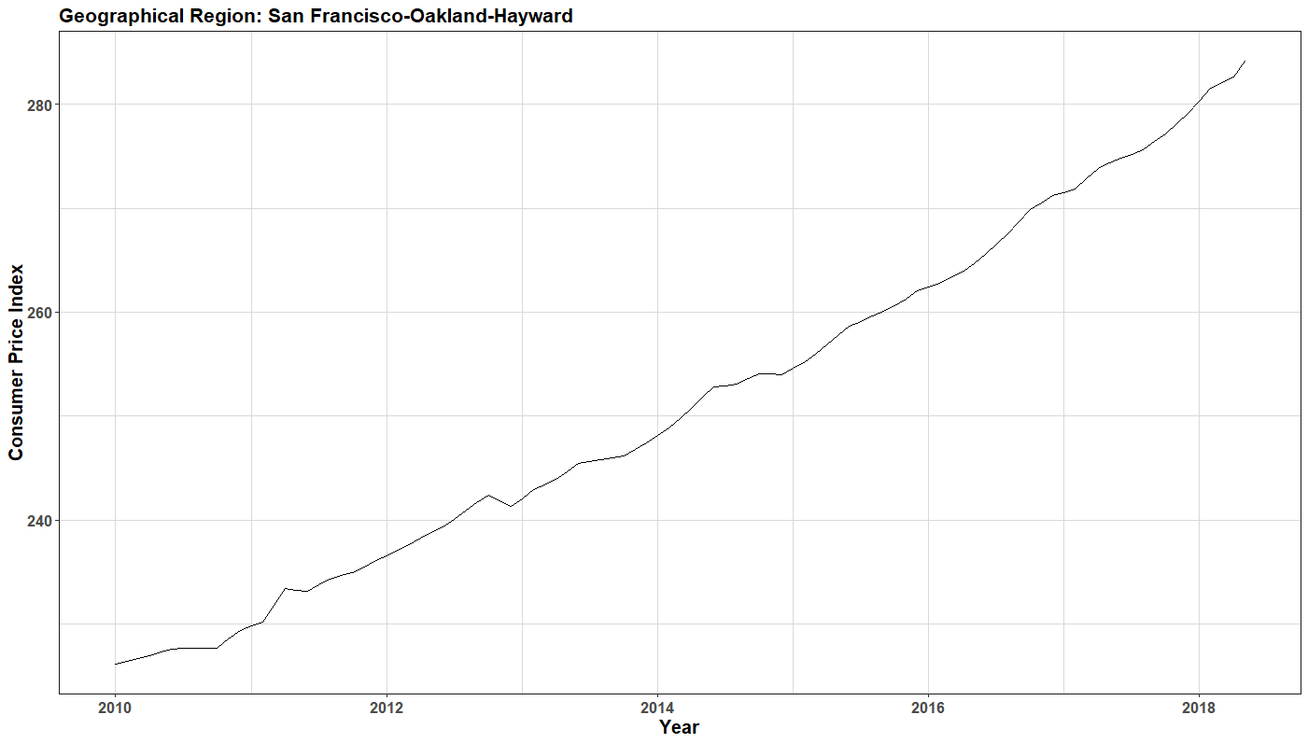
Time Series Model: Consumer Price Index
Definition:
CPI is the measure of the average change over time in the prices paid by the urban consumer for a market basket of consumed goods and services*.
CPI represents the cost of living of an average individual.
Bi-monthly CPI data for San Francisco-Oakland-Hayward region was obtained from the Federal Reserve Bank of St. Louis webpage**.
*(http://www.bls.gov/cpi)
**(http://fred.stlouisfed.org)

Slide 11
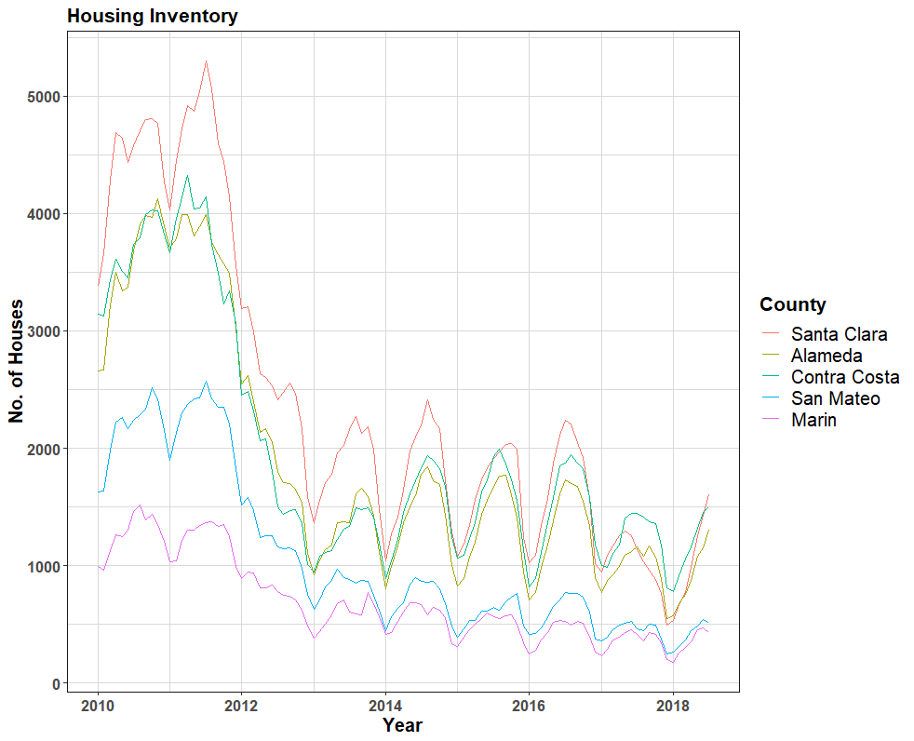
Time Series Model: Monthly Inventory
Monthly inventory time series was monthly record of houses available for sale in a county.
After the financial crisis of 2008, the sharp reduction in inventory shows the increased demand.

Slide 12
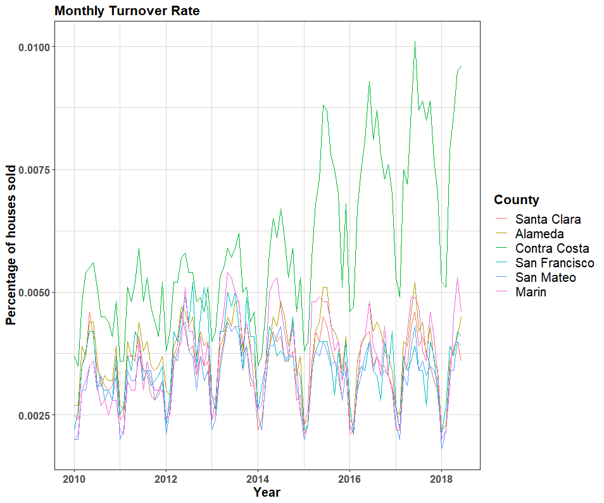
Time Series Model: Monthly Turnover
Turnover is the proportion of housing sold in a region.
Turnover rate is measure of true strength of real-estate market.

Slide 13
Time Series Model: Training & Test Sets
Training Set
Time series data from January 2010 to December 2017.
Total 96 observation.
Test Set
Time series data from January 2018 to June 2018.
6 observations.

Slide 14
Decision Trees: Basic Terminology
Bootstrapping
Take a random sample of size same as the training set with replacement from the input data.
Repeat to create multiple random sample, esp. when the sample data is limited.
Out-of-Bag Error
OOB Error is computed by using only 2/3rd of the training data for training and 1/3rd for validating the tree.
Eliminates the need of cross-validation set.

Slide 15
Decision Trees: Bagging
Steps
Take a random sample of size same as the training set with replacement from the input data.
Build a full grown tree without pruning.
Store the variable and corresponding predictor values at the terminal nodes.
Repeat the last three steps and aggregating the results
Advantage
Better reduction in variance compared to relying on a single tree output.
Limitation
If few predictive features outperform the other, these features will be included in most of the trees
Thus the final averaging will be on correlated trees which does not reduce variance effectively despite using more trees

Slide 16
Decision Trees: Random Forest
Steps
Take a random sample of size same as the training set with replacement from the input data.
Take a random subset of predictors (with replacement).
Use the predictors in second step two for splitting at branch.
Build a tree by repeating step 2 and 3.
Store the variable and corresponding predictor values at the terminal nodes.
Repeat the last five steps and aggregating the results
Advantage
Trees are more independent so better reduction in error due to variance.
Error due to bias can be reduced as even if there are large number of predictors, local features still get part in building the tree.

Slide 17
Decision Trees: Housing Price Model
 | Bagging | Random Forest
No. of Predictors | 11 | 3
OOB | 0.13% | 0.13%
Important Features | SF County Housing Prices | SF County Housing Prices
 | Time | Time
Test MSE | 29.51% | 27.36%

Slide 18
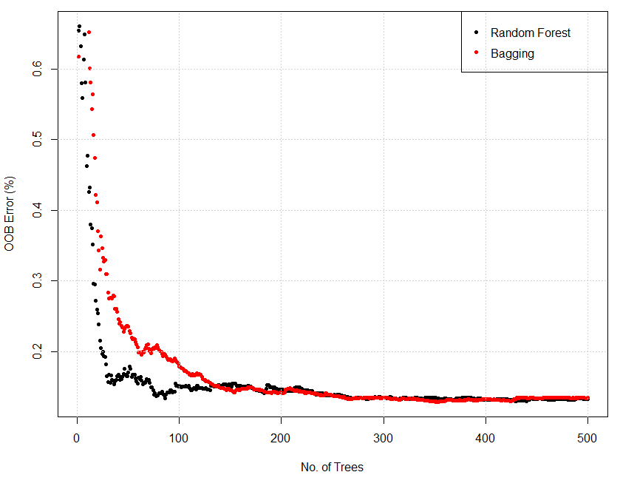
Decision Trees: OOB Error
Both errors reduced as number of tree increased.
Rate of error reduction in random forest was sharp initially compared to bagging.
After 200 trees both error were almost same and constant.

Slide 19
Decision Trees: Importance Measure-%IncMSE
Predictors | Bagging | Random Forest
Santa Clara | 9.48 | 11.32
Contra Costa | 9.35 | 9.64
San Francisco | 13.08 | 12.07
San Mateo | 8.56 | 10.17
Solano | 8.07 | 9.47
Marin | 9.33 | 10.25
Time | 10.06 | 9.97
Population | 9.85 | 9.90
Consume Price Index | 9.43 | 9.55
Monthly Inventory | 5.90 | 3.62
Turnover | 4.59 | 4.78

Slide 20
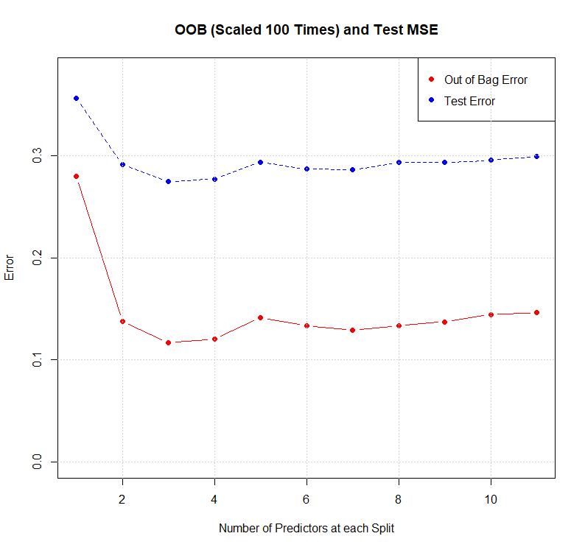
Decision Trees: Performance
Predictor subset size of 3, had the mini Test MSE.
Random forest model had 2% lower test MSE compared to bagging.
OOB had almost same trend as MSE.
Besides 1, 3 and 4 predictors subset size, bagging performed almost same as random forest as number of predictors were not that too many.
In terms of prediction both models had relatively high test MSE.

Slide 21
Time Series Forecasting

Slide 22
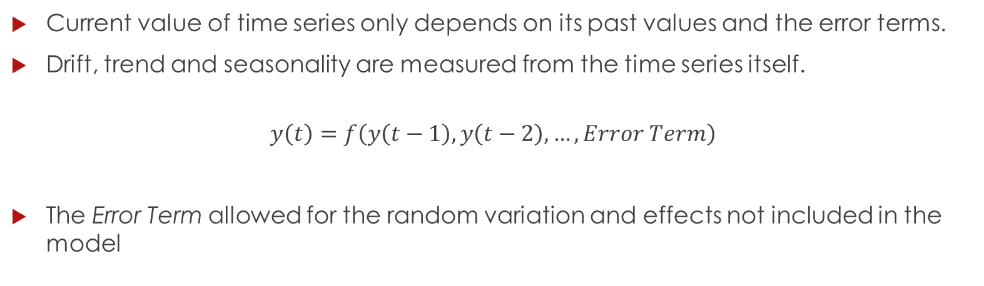
Time Series Model: Introduction
Current value of time series only depends on its past values and the error terms.
Drift, trend and seasonality are measured from the time series itself.
$$y\left(t\right)=f\left(y\left(t−1\right), y\left(t−2\right),…,Error Term\right)$$
The Error Term allowed for the random variation and effects not included in the model

Slide 23
Time Series Model: Training & Test Sets
In the time series modeling, Alameda County housing price data was used to develop a forecasting model.
Training Set
Median-monthly housing prices from April 1996 to December 2017.
Total 261 observation
Test Set
Median-monthly housing prices from January 2018 to July 2018
7 observations.

Slide 24
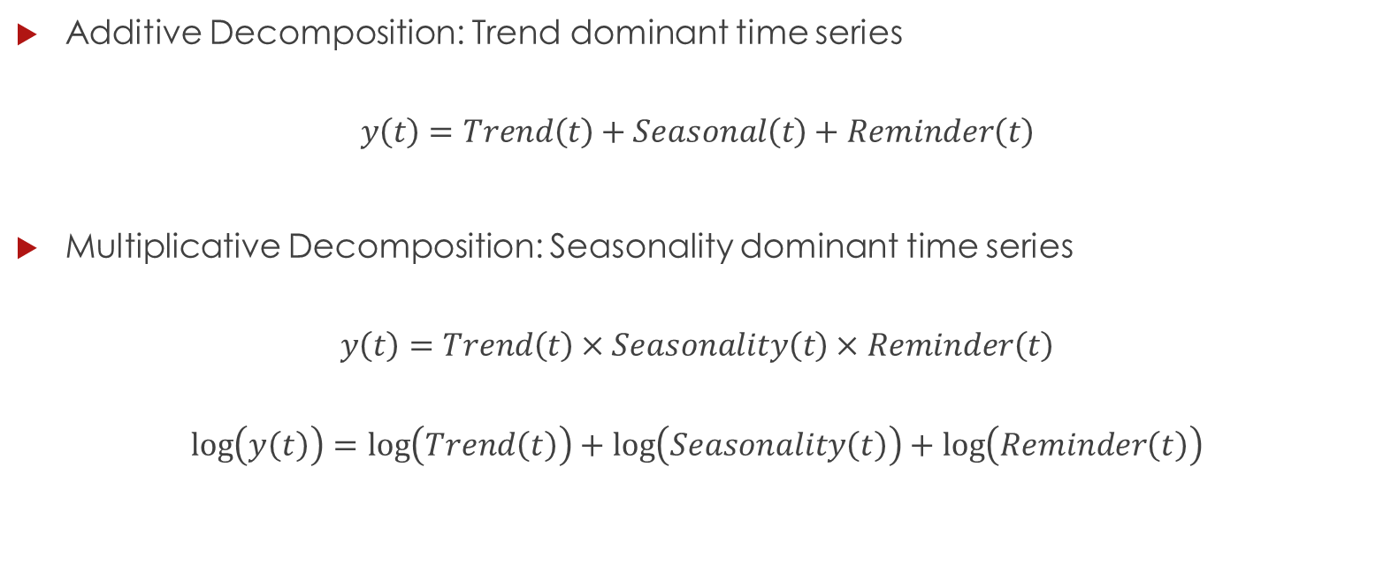
Time Series Model: Decomposition
Additive Decomposition: Trend dominant time series
$$y\left(t\right)=Trend\left(t\right)+Seasonal\left(t\right)+Reminder\left(t\right)$$
Multiplicative Decomposition: Seasonality dominant time series
$$y\left(t\right)=Trend\left(t\right)×Seasonality\left(t\right)×Reminder\left(t\right)$$
$$\log\left(y\left(t\right)\right)=\log\left(Trend\left(t\right)\right)+\log\left(Seasonality\left(t\right)\right)+\log\left(Reminder\left(t\right)\right)$$

Slide 25
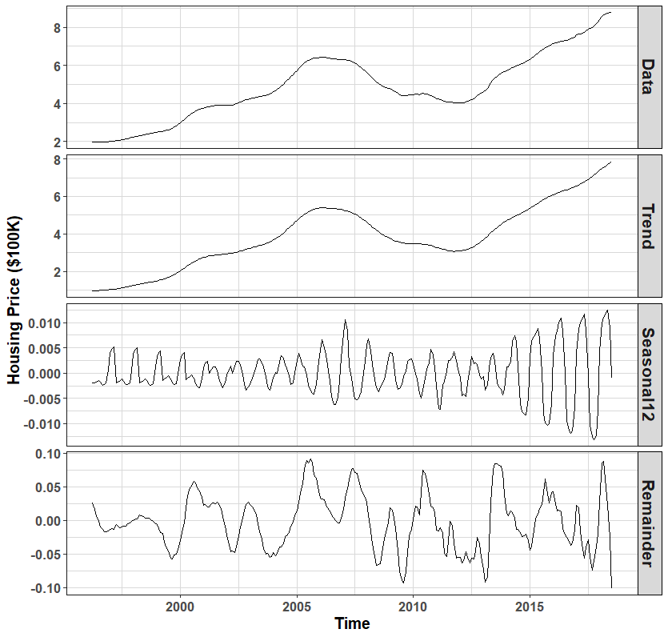
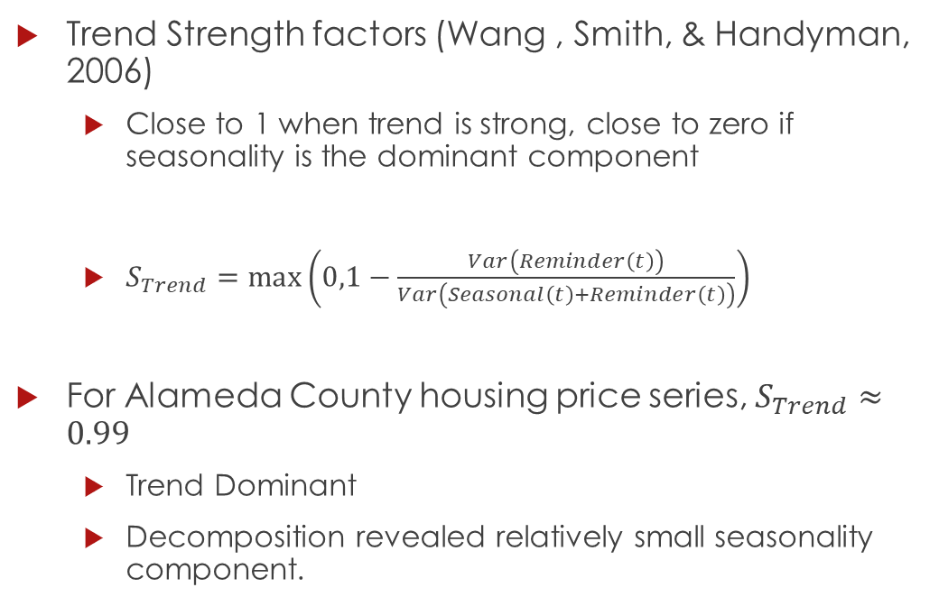
Time Series Model: Trend Strength Test
Trend Strength factors (Wang , Smith, & Handyman, 2006)
Close to 1 when trend is strong, close to zero if seasonality is the dominant component
$S_{Trend}=max\left(0,1−\frac{Var\left(Reminder\left(t\right)\right)}{Var\left(Seasonal\left(t\right)+Reminder\left(t\right)\right)}\right)$
For Alameda County housing price series, $S_{Trend}≈0.99$
Trend Dominant
Decomposition revealed relatively small seasonality component.

Slide 26
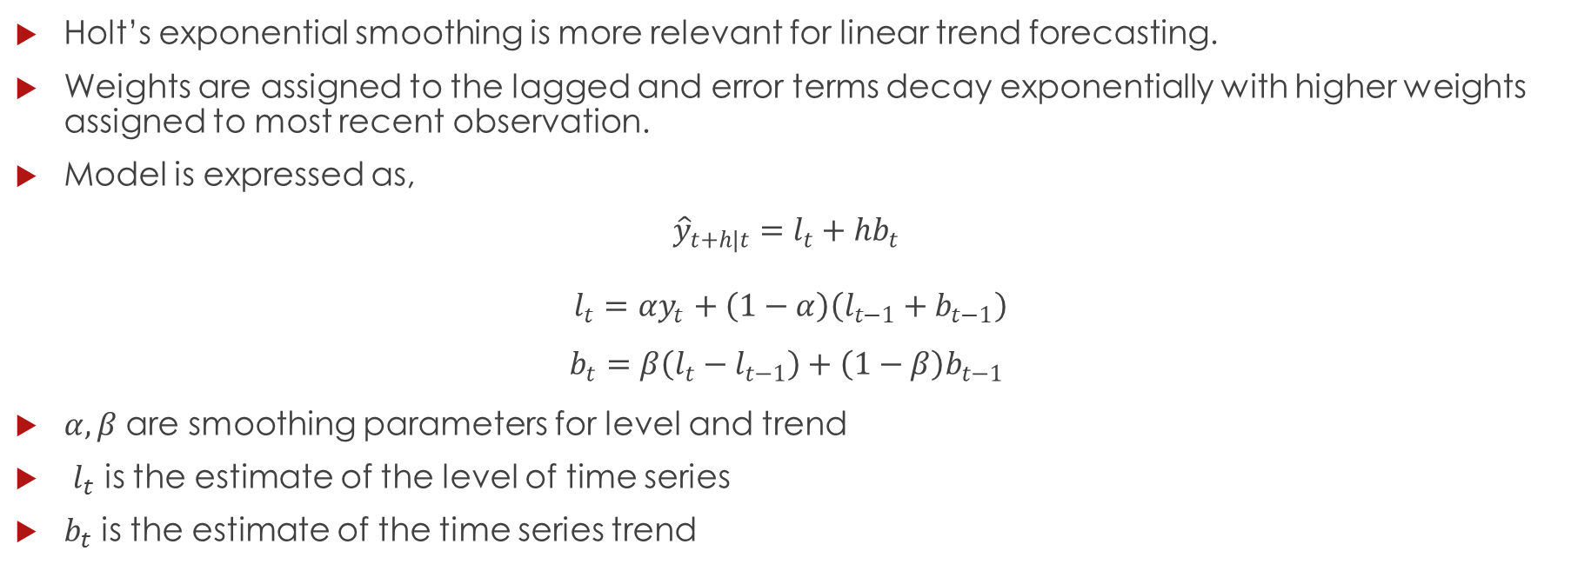
Time Series Model: Holt’s Smoothing
Holt’s exponential smoothing is more relevant for linear trend forecasting.
Weights are assigned to the lagged and error terms decay exponentially with higher weights assigned to most recent observation.
Model is expressed as,
$${\hat{y}}_{t+h|t}=l_{t}+hb_{t}$$
$l_{t}={αy}_{t}+\left(1−α\right)\left(l_{t−1}+b_{t−1}\right)$
$$b_{t}=β\left(l_{t}−l_{t−1}\right)+\left(1−β\right)b_{t−1}$$
$α, β$ are smoothing parameters for level and trend
$l_{t}$ is the estimate of the level of time series
$b_{t}$ is the estimate of the time series trend

Slide 27
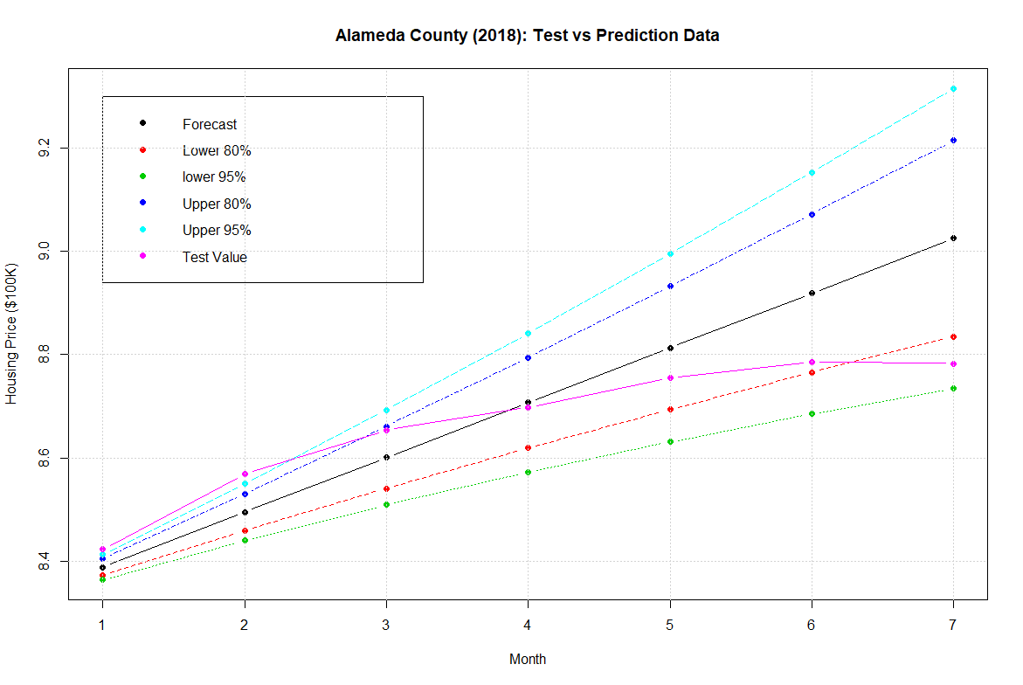
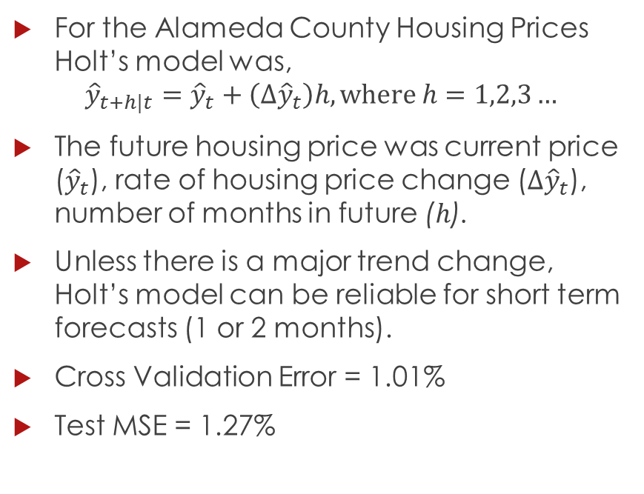
Time Series Model: Holt’s Smoothing
For the Alameda County Housing Prices Holt’s model was,
$${\hat{y}}_{t+h|t}={\hat{y}}_{t}+\left(∆{\hat{y}}_{t}\right)h, where h=1,2,3…$$
The future housing price was current price (${\hat{y}}_{t}$), rate of housing price change ($∆{\hat{y}}_{t}$), number of months in future ($h$).
Unless there is a major trend change, Holt’s model can be reliable for short term forecasts (1 or 2 months).
Cross Validation Error = 1.01%
Test MSE = 1.27%

Slide 28
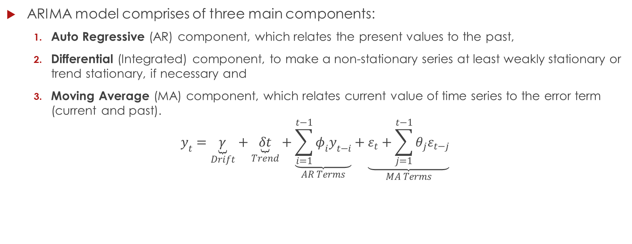
Time Series Model: ARIMA(p,d,q)
ARIMA model comprises of three main components:
Auto Regressive (AR) component, which relates the present values to the past,
Differential (Integrated) component, to make a non-stationary series at least weakly stationary or trend stationary, if necessary and
Moving Average (MA) component, which relates current value of time series to the error term (current and past).
$$y_{t}=\underset{Drift}{\underbrace{γ}}+\underset{Trend}{\underbrace{δt}}+\underset{AR Terms}{\underbrace{\sum_{i=1}^{t−1}{φ_{i}y_{t−i}}}}+\underset{MA Terms}{\underbrace{ε_{t}+\sum_{j=1}^{t−1}{θ_{j}ε_{t−j}}}}$$

Slide 29
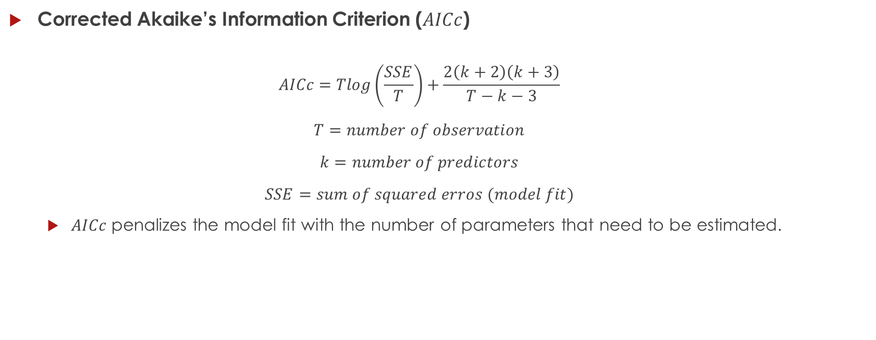
Time Series Model: Model Selection Criteria - I
Corrected Akaike’s Information Criterion ($AICc$)
$$AICc=Tlog\left(\frac{SSE}{T}\right)+\frac{2\left(k+2\right)\left(k+3\right)}{T−k−3}$$
$$T=number of observation$$
$$k=number of predictors$$
$$SSE=sum of squared erros (model fit)$$
$AICc$ penalizes the model fit with the number of parameters that need to be estimated.

Slide 30
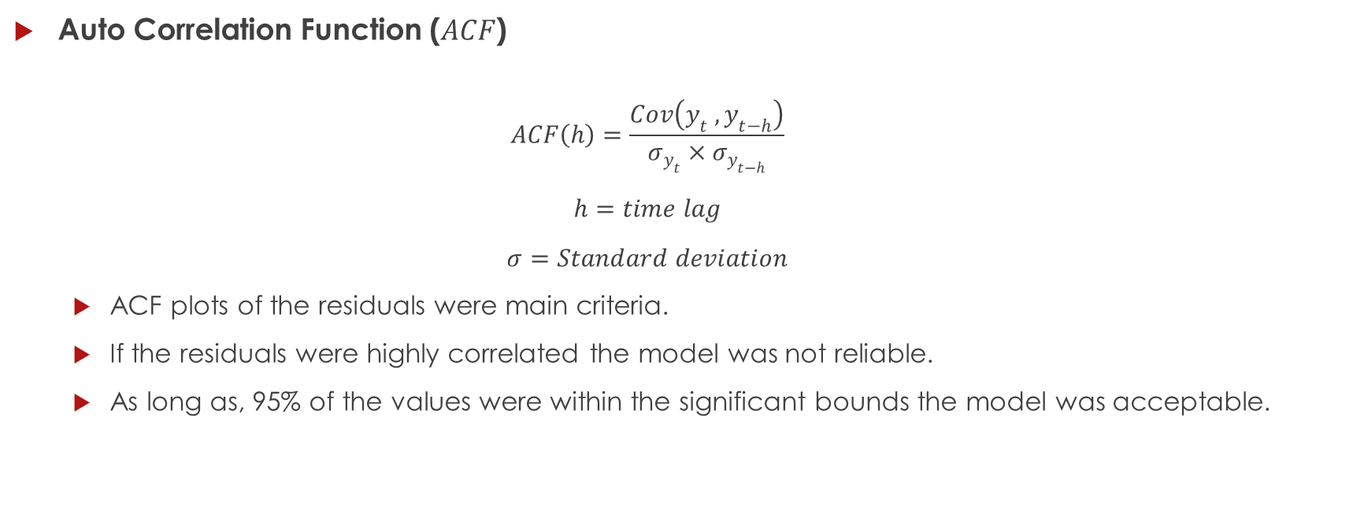
Time Series Model: Model Selection Criteria - II
Auto Correlation Function ($ACF$)
$$ACF\left(h\right)=\frac{Cov\left(y_{t} , y_{t−h}\right)}{σ_{y_{t}}×σ_{y_{t−h}}}$$
$$h=time lag$$
$$σ=Standard deviation$$
ACF plots of the residuals were main criteria.
If the residuals were highly correlated the model was not reliable.
As long as, 95% of the values were within the significant bounds the model was acceptable.

Slide 31
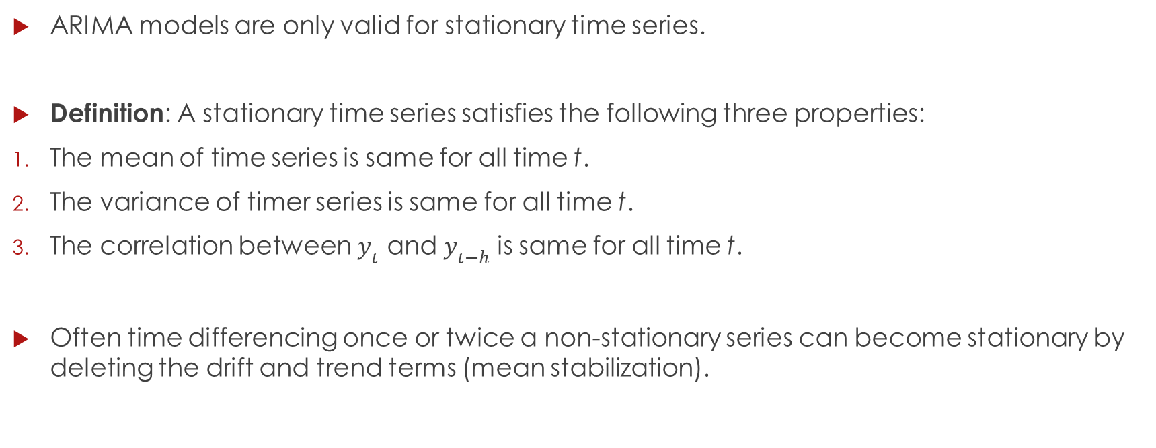
Time Series Model: Stationarity
ARIMA models are only valid for stationary time series.
Definition: A stationary time series satisfies the following three properties:
The mean of time series is same for all time t.
The variance of timer series is same for all time t.
The correlation between $y_{t}$ and $y_{t−h}$ is same for all time t.
Often time differencing once or twice a non-stationary series can become stationary by deleting the drift and trend terms (mean stabilization).

Slide 32
Time Series Model: Unit Root Tests
Unit Root tests are hypothesis tests which verify if a given series is stationary of not.
Two types of unit root test used in this study:
ADF Test: If null hypothesis is true, then the series has a unit root and series is non-stationary.
KPSS Test: If null hypothesis is true, then series does not have unit root and it is stationary.
Both tests were implemented in R programming language using urca package.

Slide 33
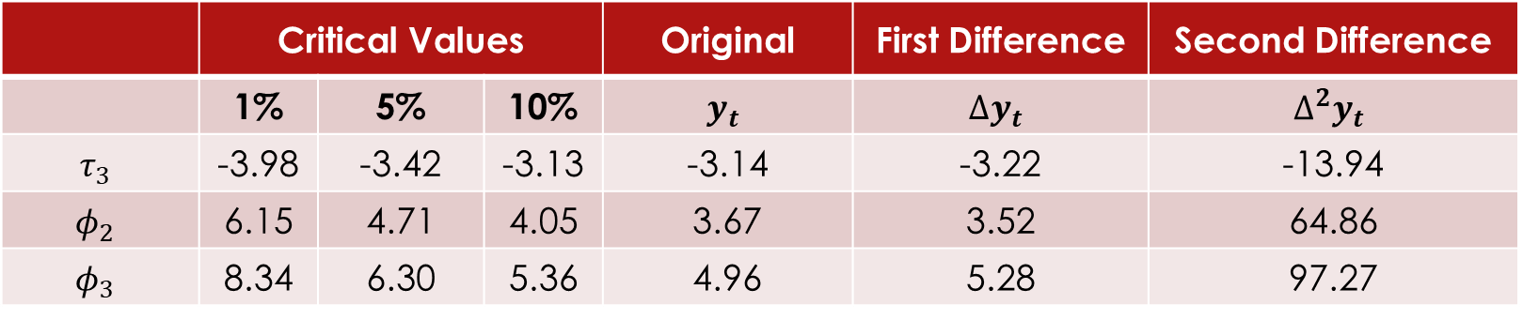
Time Series Model: Unit Root Tests
KPSS Test:
$$y_{t}=τ_{3}y_{t−1}+φ_{2}+φ_{3}t+ε$$
 | Critical Values |  |  | Original | First Difference | Second Difference
 | 1% | 5% | 10% | $$y_{t}$$ | $$∆y_{t}$$ | $$∆^{2}y_{t}$$
$$τ_{3}$$ | -3.98 | -3.42 | -3.13 | -3.14 | -3.22 | -13.94
$$φ_{2}$$ | 6.15 | 4.71 | 4.05 | 3.67 | 3.52 | 64.86
$$φ_{3}$$ | 8.34 | 6.30 | 5.36 | 4.96 | 5.28 | 97.27
First (< 5%) and second difference (<1%) were rejected the null hypothesis.

Slide 34
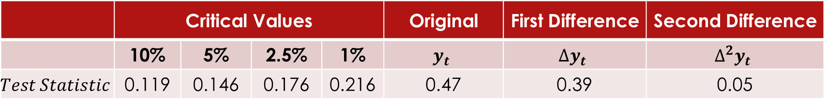
Time Series Model: Unit Root Tests
KPSS Test:
 | Critical Values |  |  |  | Original | First Difference | Second Difference
 | 10% | 5% | 2.5% | 1% | $$y_{t}$$ | $$∆y_{t}$$ | $$∆^{2}y_{t}$$
$$Test Statistic$$ | 0.119 | 0.146 | 0.176 | 0.216 | 0.47 | 0.39 | 0.05
Second difference test statistic was less than 1% critical value.

Slide 35
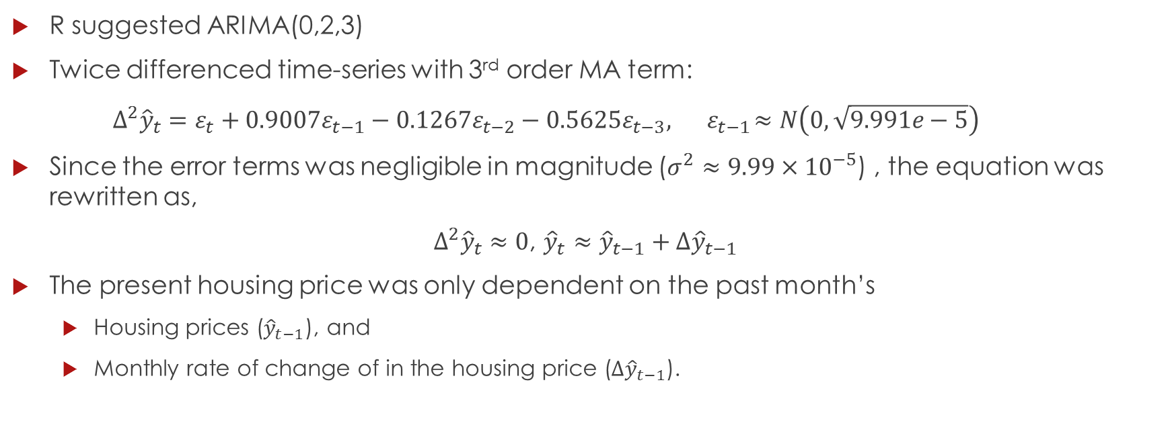
Time Series Model: auto.arima in R
R suggested ARIMA(0,2,3)
Twice differenced time-series with 3rd order MA term:
$${Δ^{2}\hat{y}}_{t}=ε_{t}+0.9007ε_{t−1}−0.1267ε_{t−2}−0.5625ε_{t−3}, { ε}_{t−1}≈N\left(0,\sqrt{9.991e−5}\right)$$
Since the error terms was negligible in magnitude ($σ^{2}≈9.99×{10}^{−5}$) , the equation was rewritten as,
${Δ^{2}\hat{y}}_{t}≈0$, ${{\hat{y}}_{t}≈{\hat{y}}_{t−1}+∆\hat{y}}_{t−1}$
The present housing price was only dependent on the past month’s
Housing prices (${\hat{y}}_{t−1}$), and
Monthly rate of change of in the housing price (${∆\hat{y}}_{t−1}$).

Slide 36
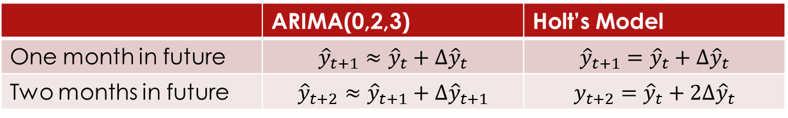
Time Series Model: ARIMA(0,2,3)
Similar to Holt’s exponential predictor, the suggested forecasting model was linear.
ARIMA(0,2,3) was step prediction, while Holt’s exponential smoothing function was level based.
 | ARIMA(0,2,3) | Holt’s Model
One month in future | $${{\hat{y}}_{t+1}≈{\hat{y}}_{t}+∆\hat{y}}_{t}$$ | $${{\hat{y}}_{t+1}={\hat{y}}_{t}+∆\hat{y}}_{t}$$
Two months in future | $${{\hat{y}}_{t+2}≈{\hat{y}}_{t+1}+∆\hat{y}}_{t+1}$$ | $${y_{t+2}={\hat{y}}_{t}+2∆\hat{y}}_{t}$$

Slide 37
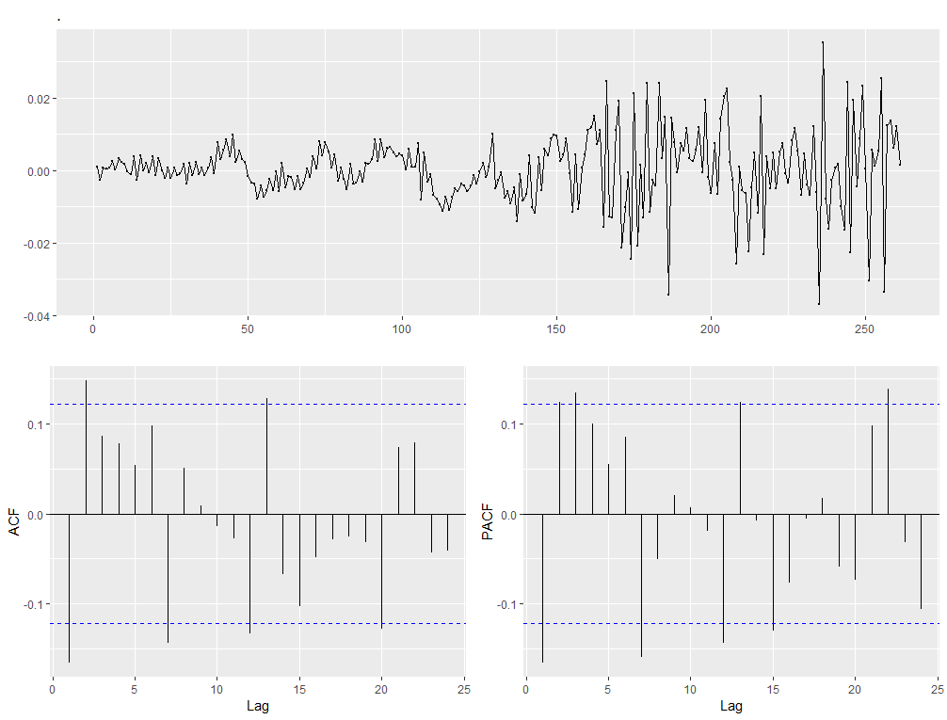
Time Series Model: ARIMA(0,2,3)
Residual Plot Criteria
ACF and PACF plots suggested that the residuals were correlated.
ACF exceeded the significant bound at first and second lag significantly.
PACF at lag 1, 2 3 and 6 was higher than the critical 95% bound.
The model was not reliable for future predictions based on the ACF plot criteria.

Slide 38
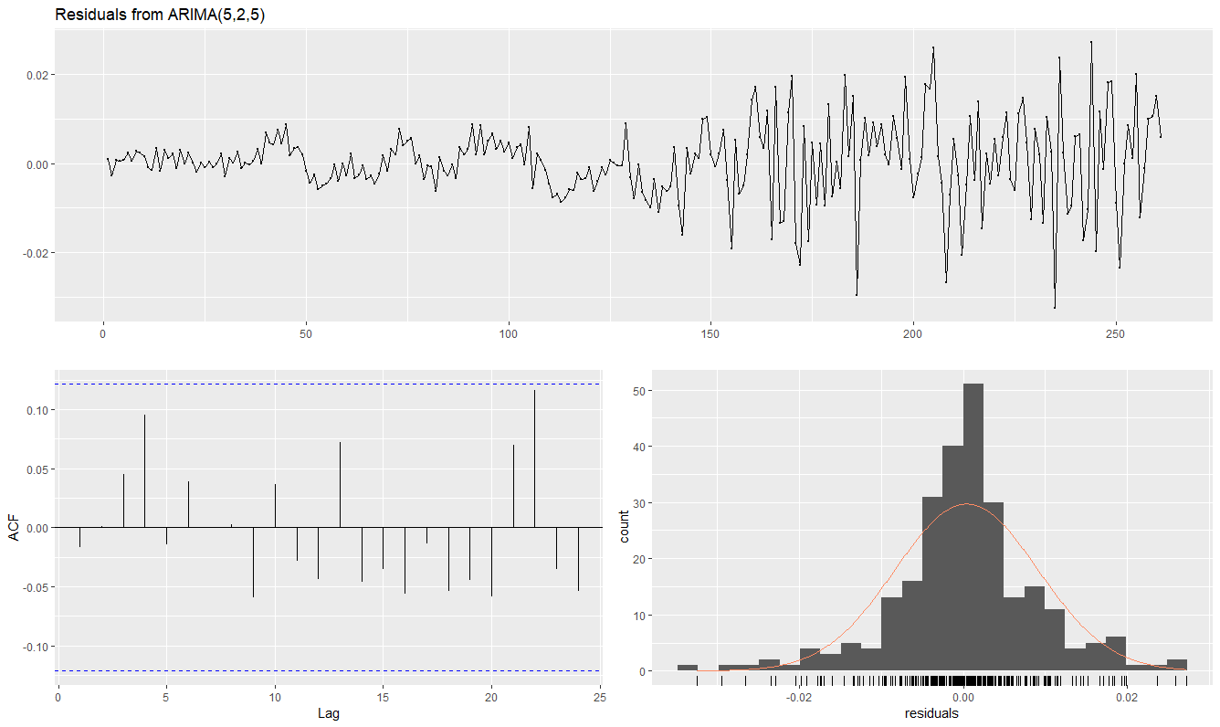
Time Series Model: ARIMA(5,2,5)
Based on trial and error ARIMA(5,2,5) satisfied both AICc and residual plot criterion over ARIMA(0,2,3).
ACF was within the significant bounds and the residuals were almost normally distributed.
 | AICc
ARIMA(0,2,3) | -1642.83
ARIMA(5,2,5) | -1681.11

Slide 39
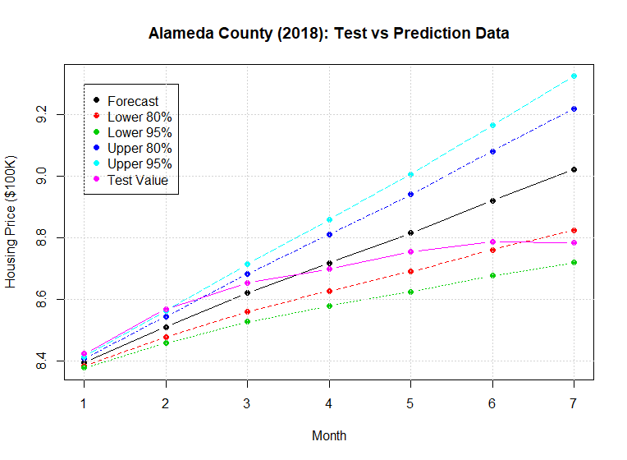
Time Series Model: ARIMA(5,2,5)
Even though the model satisfied the selection criterion, it performed worst than ARIMA(0,2,3) on the test data.
Due to double differencing, the forecast predictions for both ARIMA models were almost linear.
 | Test MSE
ARIMA(0,2,3) | 0.72%
ARIMA(5,2,5) | 1.22%

Slide 40
Time Series Model: Breakpoint Analysis
In order to improve on the prediction accuracy, structural changes in time series were analyzed.
Breakpoint analysis divides a time series in different zones and fits a polynomial functions as the approximation to original trend.
Thus study considered the constant and linear functions to approximate the partitioned time series.
Bayesian Information Criteria (BIC) was used for selecting the optimal number of partitions

Slide 41
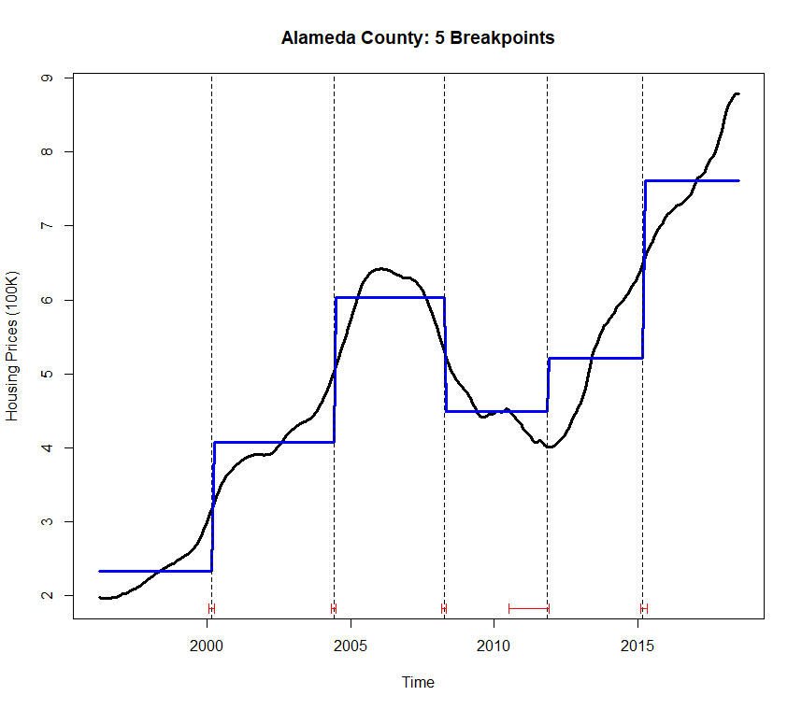
Time Series Model: Constant Fit
A constant fit model recommended 5 breakpoints corresponding to minimum BIC error.
The constant fit did not catch the trend of the partitioned zones.

Slide 42
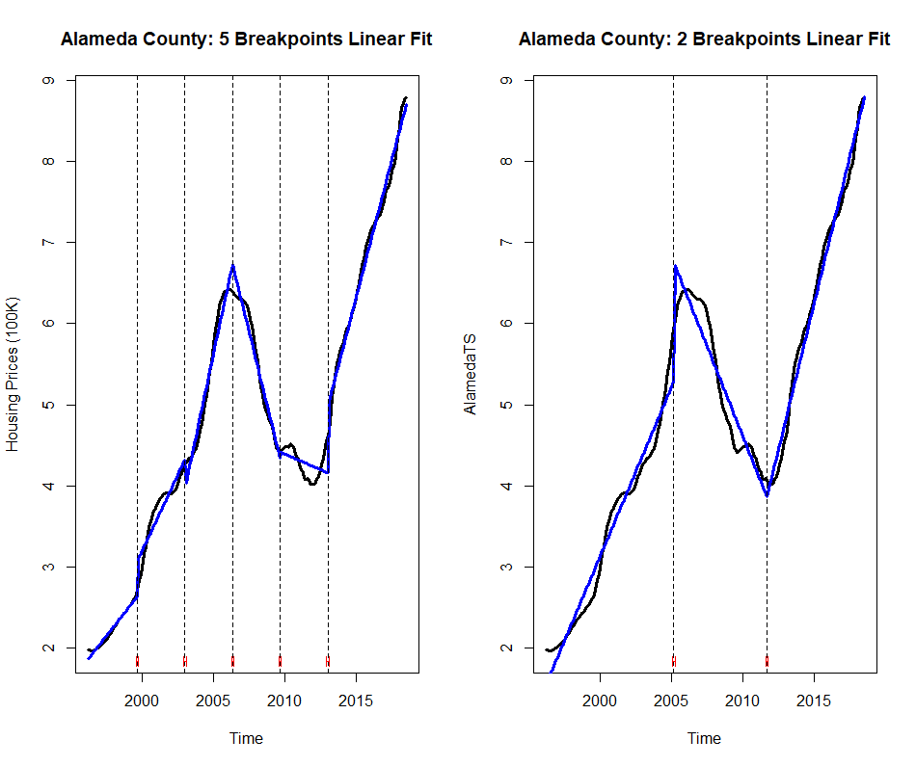
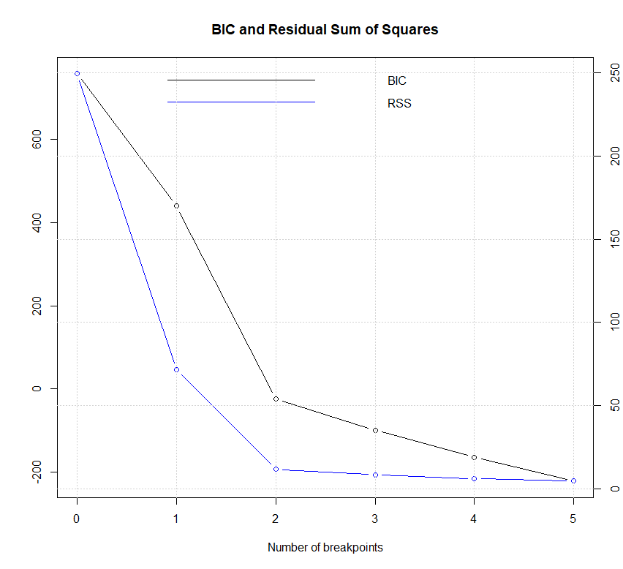
Time Series Model: Linear Fit
A linear fit model recommended 5 breakpoints corresponding to minimum BIC error.
The error reduction rate after 2 breakpoints was significantly low.
Both breakpoints were considered for the ARIMA models.

Slide 43
Time Series Model: ARIMA with Breakpoints
Breakpoint analysis provided insight into the structural change.
Due to wide variation in trend, data after the last breakpoint was used for ARIMA modeling.
 | 3 partition model | 6 partition model
1st break point | 2005-03-01 | 1999-09-01
2nd break points | 2011-09-01 | 2003-01-01
3rd break point | NA | 2006-05-01
4th break point | NA | 2009-09-01
5th break point | NA | 2013-01-01
Training Set | 2011-09-01 to 2017-12-01 | 2013-01-01 to 2017-12-01
Test Set | 2018-01-01 to 2018-07-01 | 2018-01-01 to 2018-07-01

Slide 44
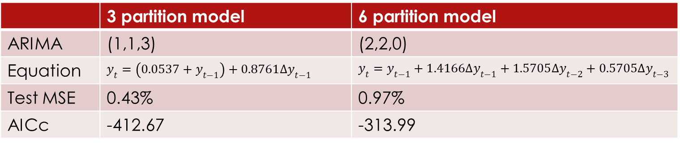
Time Series Model: ARIMA with Breakpoints
Both models satisfied the ACF plot criteria.
AICc of 3 partition model was less than 6 partition model
3 partition model performed better than 6 partition model.
 | 3 partition model | 6 partition model
ARIMA | (1,1,3) | (2,2,0)
Equation | $$y_{t}=\left(0.0537+y_{t−1}\right)+0.8761∆y_{t−1}$$ | $$y_{t}=y_{t−1}+1.4166∆y_{t−1}+1.5705∆y_{t−2}+0.5705∆y_{t−3}$$
Test MSE | 0.43% | 0.97%
AICc | -412.67 | -313.99

Slide 45
Dynamic Regression Model

Slide 46
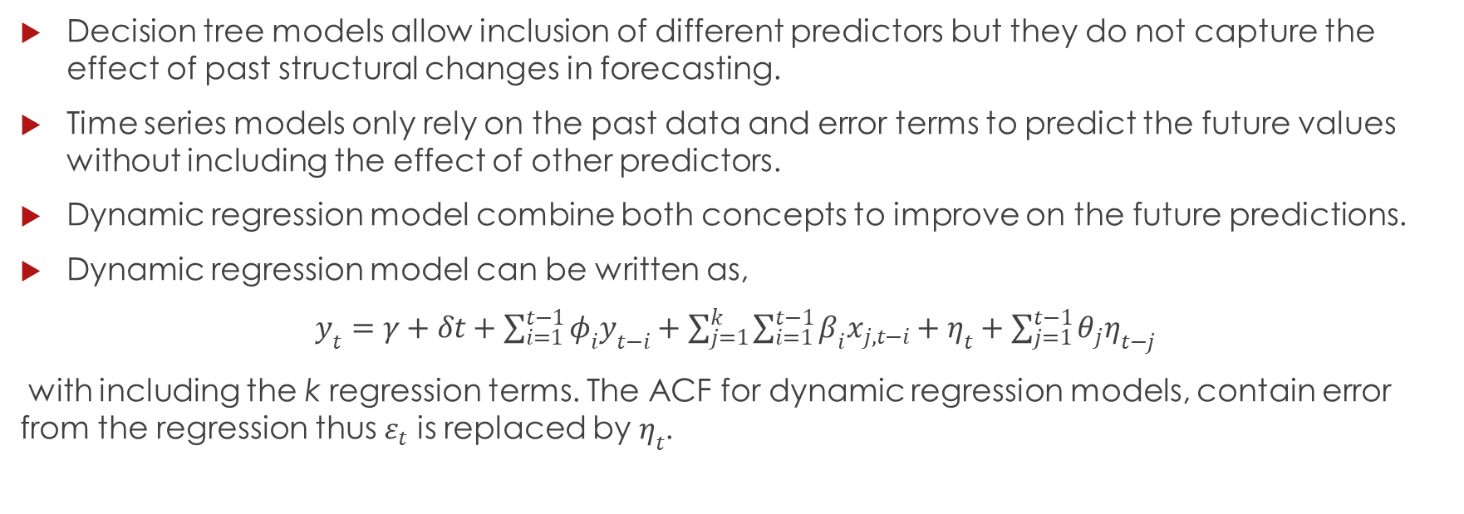
Dynamic Regression Model
Decision tree models allow inclusion of different predictors but they do not capture the effect of past structural changes in forecasting.
Time series models only rely on the past data and error terms to predict the future values without including the effect of other predictors.
Dynamic regression model combine both concepts to improve on the future predictions.
Dynamic regression model can be written as,
$y_{t}=γ+δt+\sum_{i=1}^{t−1}{φ_{i}y_{t−i}}+\sum_{j=1}^{k}{\sum_{i=1}^{t−1}{β_{i}x_{j,t−i}}}+η_{t}+\sum_{j=1}^{t−1}{θ_{j}η_{t−j}}$
with including the k regression terms. The ACF for dynamic regression models, contain error from the regression thus $ε_{t}$ is replaced by$η_{t}$.

Slide 47
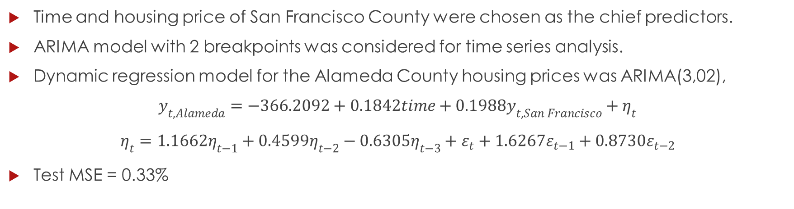
Dynamic Regression Model
Time and housing price of San Francisco County were chosen as the chief predictors.
ARIMA model with 2 breakpoints was considered for time series analysis.
Dynamic regression model for the Alameda County housing prices was ARIMA(3,02),
$$y_{t,Alameda}=−366.2092+0.1842time+0.1988y_{t,San Francisco}+η_{t}$$
$$η_{t}=1.1662η_{t−1}+0.4599η_{t−2}−0.6305η_{t−3}+ε_{t}+1.6267ε_{t−1}+0.8730ε_{t−2}$$
Test MSE = 0.33%

Slide 48
Conclusions
Decision Tree Models:
Both models suggested the housing prices in San Francisco County were relatively more important in predictive models for the Alameda County housing prices.
Performance wise the random forest model was better than bagging model with smaller test error.
 | Test MSE | No. of Predictors at each split
Bagging | 29.51% | 11
Random Forest | 27.36% | 3

Slide 49
Conclusions
Time Series Models:
All time series models, performed relatively better than decision tree model in term of the test MSE.
Performance of ARIMA model was better when 2 structural breakpoints were incorporated.
All time series model suggested that the housing price and the rate of change in housing prices over the previous month were crucial for predicting the current values.
 | Test MSE | Notes
ARIMA(0,2,3) | 0.73% | auto.arima
ARIMA(5,2,5) | 1.22% | Random trials
ARIMA(1,1,3) | 0.43% | Time series with 2 breakpoints
ARIMA(2,2,0) | 0.97% | Time series with 5 breakpoints

Slide 50
Conclusions
Dynamic Regression Model:
Knowledge from both, decision trees and the time series model, was combined in the dynamic regression model.
T he model considered the past housing prices and the two most prominent (un-correlated) predictors based on the decision tree models: time and the housing prices in the San Francisco County.
The dynamic regression model outperformed all other models in terms of the test MSE, 0.33%.
Based on the final model it was suggested that future housing prices of Alameda county can be computed with relative accuracy by considering the housing price data of past four months, the housing prices in San Francisco as long as there are no significant structural changes.

Slide 51
Thank You!

